Slide 1
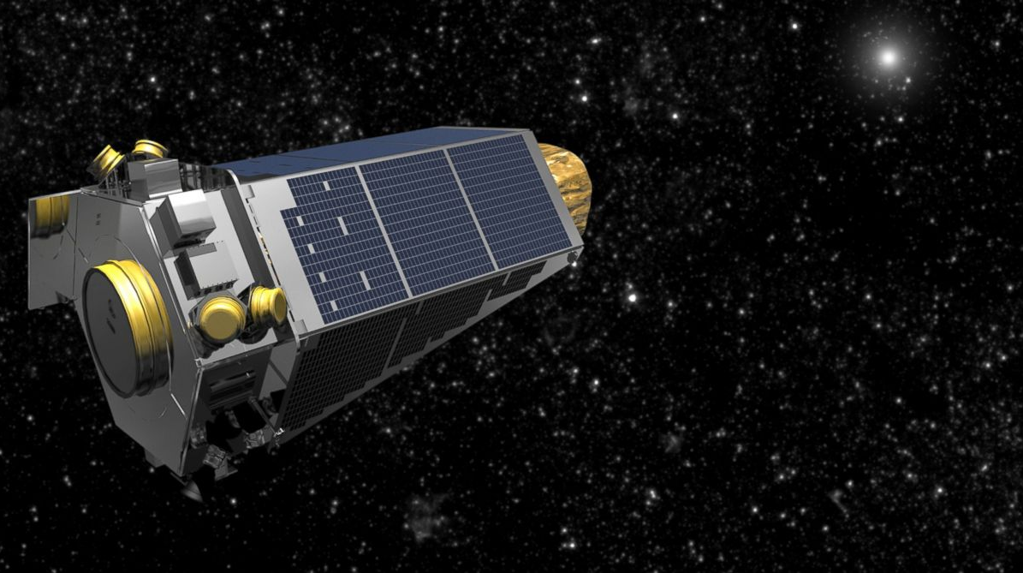

Planet Hunting with Python Project Kick-Off 2020
Your research project
Stefanie Hurrell
Introduction to Exoplanets & Kepler
Prof Richard Nelson

Slide 2
What is PRiSE?
Physics Research in School Environments
Proper research done by you!
Extension of the physics you do in school
Work with a Queen Mary university researcher
What happens during PRiSE?
You work on your project in small groups
Supported by your teacher
You meet with your Queen Mary academic during the year (at least twice)
You can choose to present your results at our closing celebration in March

Slide 3


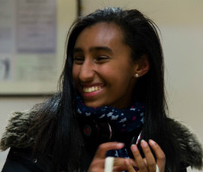
Why should I get involved?
Design
Physics
Maths
Computing

Slide 4
Who can help me?
Yourself
Independent reading (handout & more) and thinking!
Your colleagues
Work in small groups, discuss literature/method/analysis etc.
Your teacher
Primary day-to-day supervisor
Queen Mary
Your university lead will provide assistance/expertise as required
They will visit you (in school or virtually in December and February but you can ask your teacher to get in touch at other times)

Slide 5
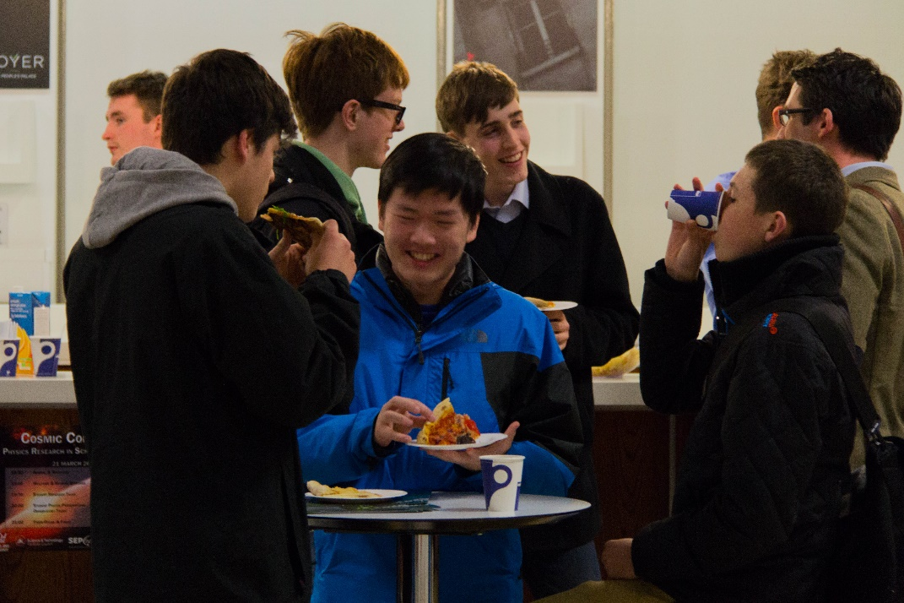
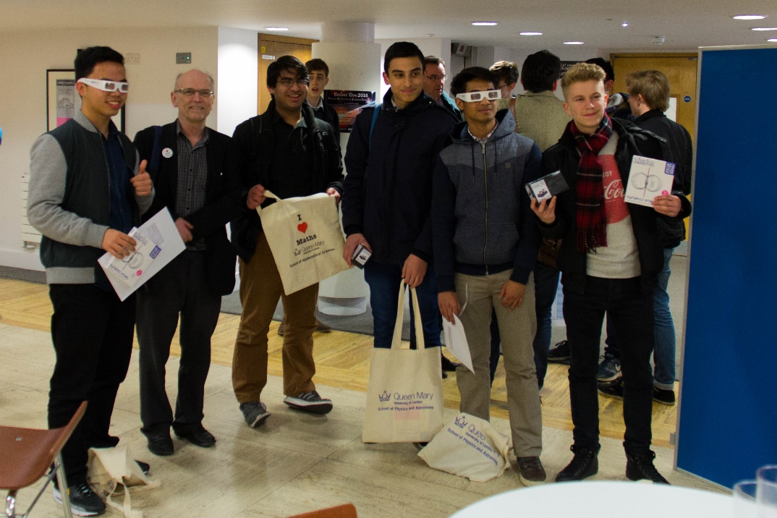
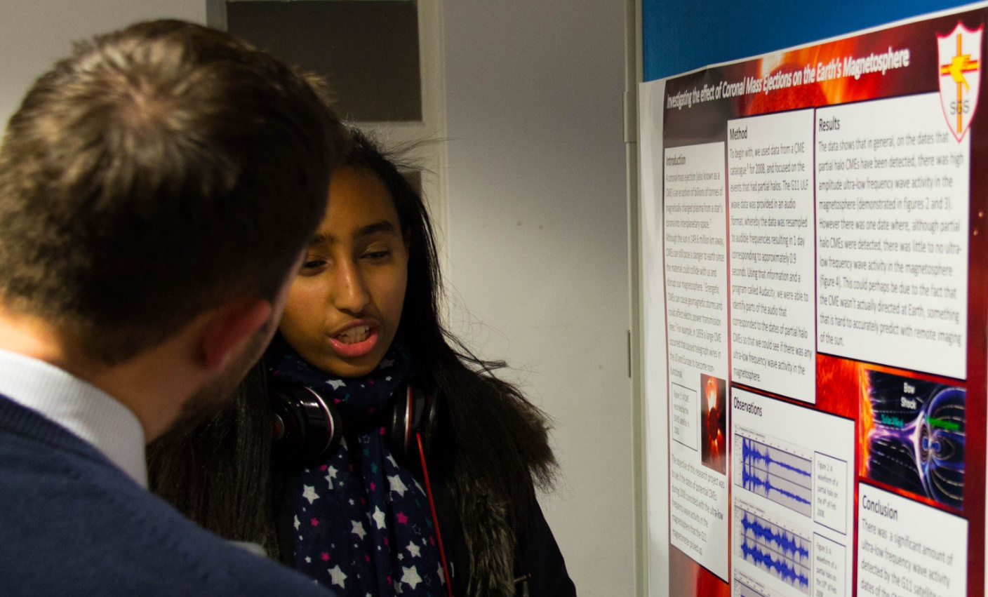
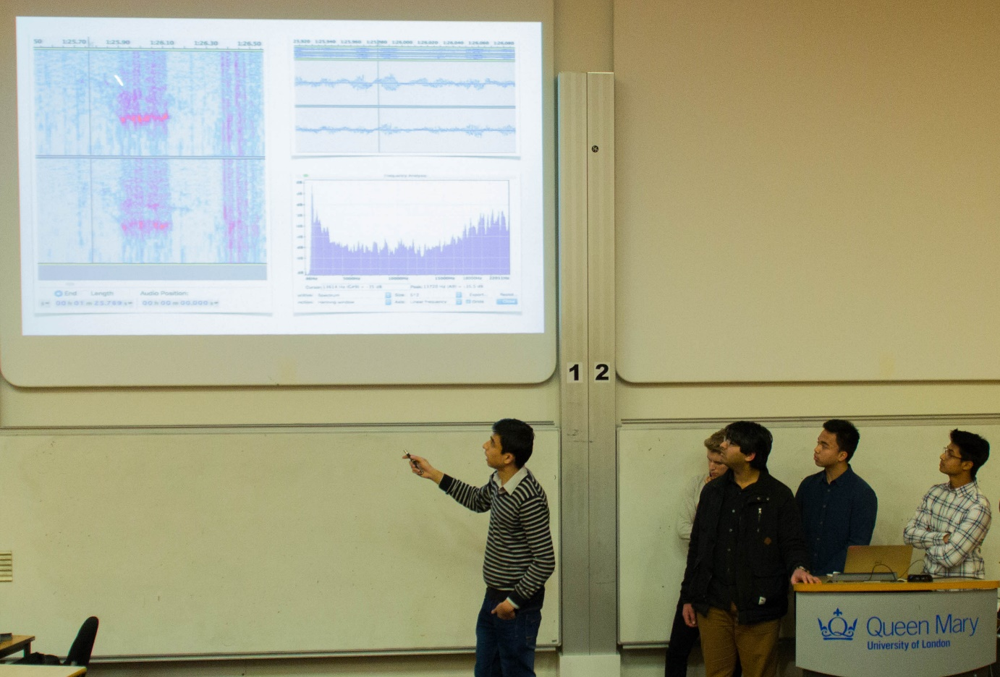

Slide 6
What do I do first?
Form small research groups (4-5 people)
Read the student guide
Try the exercises
Try Python introductory tasks
Do extra reading where necessary
Initial Project: Kepler Data Analysis Exercises

Slide 7
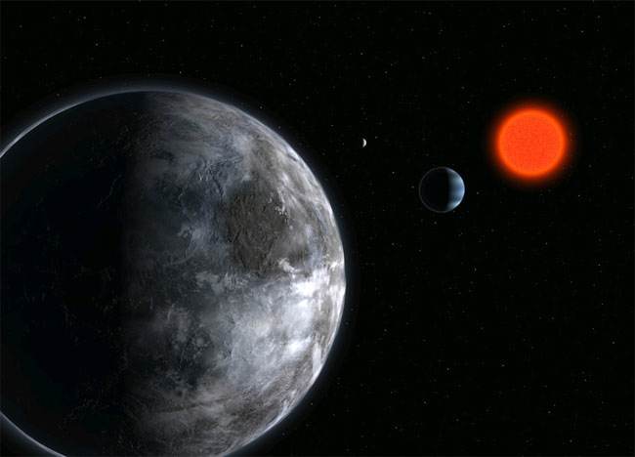
Introduction to Exoplanets & Kepler
Professor Richard Nelson

Slide 8

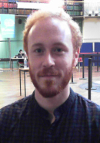
Who are we?
Richard Nelson - Professor of Astronomy & Mathematics at Queen Mary
Francesco Lovascio - PhD student in Astronomy at Queen Mary
Our famous Octagon room
Student accommodation

Slide 9
Solar System Planets
Our famous Octagon room
Student accommodation

Slide 10
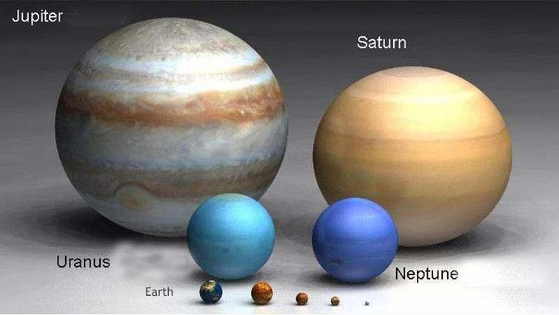
Relative sizes of Solar System planets
Our famous Octagon room
Student accommodation

Slide 11
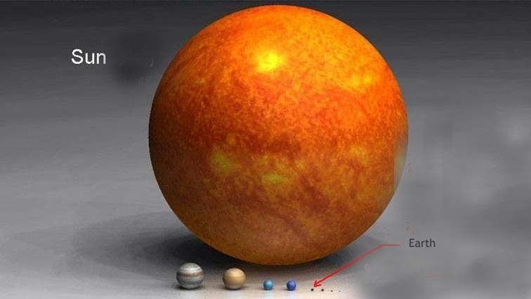
The Sun is 1000 times more massive than Jupiter. Its radius is 10 times larger than Jupiter’s.
Jupiter is 300 times more massive than Earth.
Its radius is 11 times larger than Earth’s.
Neptune is 17 times more massive than Earth. Its radius is 4 times larger than Earth’s.
Our famous Octagon room
Student accommodation

Slide 12
Extrasolar Planetary Systems
Our famous Octagon room
Student accommodation

Slide 13
Planet finding and detection methods
We will consider two methods of detecting exoplanets:
i. Radial velocity searches
ii. Transit monitoring
Our famous Octagon room
Student accommodation

Slide 14
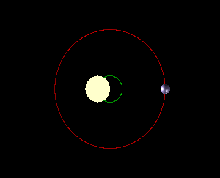
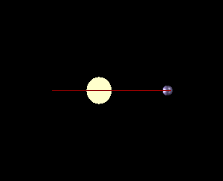
Radial velocity method
When a planet orbits a star it causes the star to wobble back and forth because both the star and planet orbit their common centre of mass
Looking down on planet and star
Looking at planet and star edge-on
Our famous Octagon room
Student accommodation

Slide 15
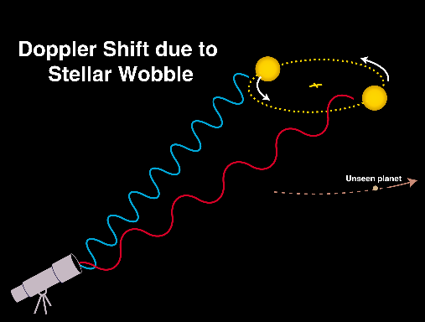
As star moves towards observer, starlight is blue-shifted
As it recedes the starlight is red-shifted Astronomers detect the red- and blue-shifted light ⇒ planet!
Our famous Octagon room
Student accommodation

Slide 16
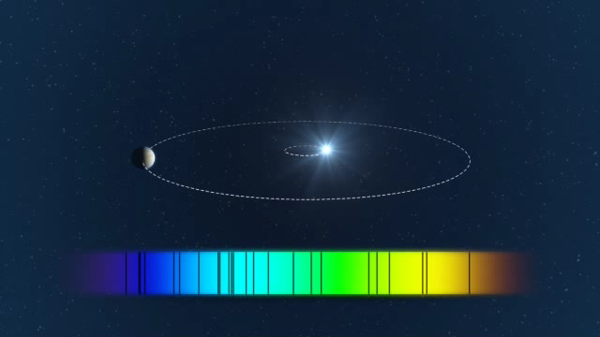
Our famous Octagon room
Student accommodation

Slide 17
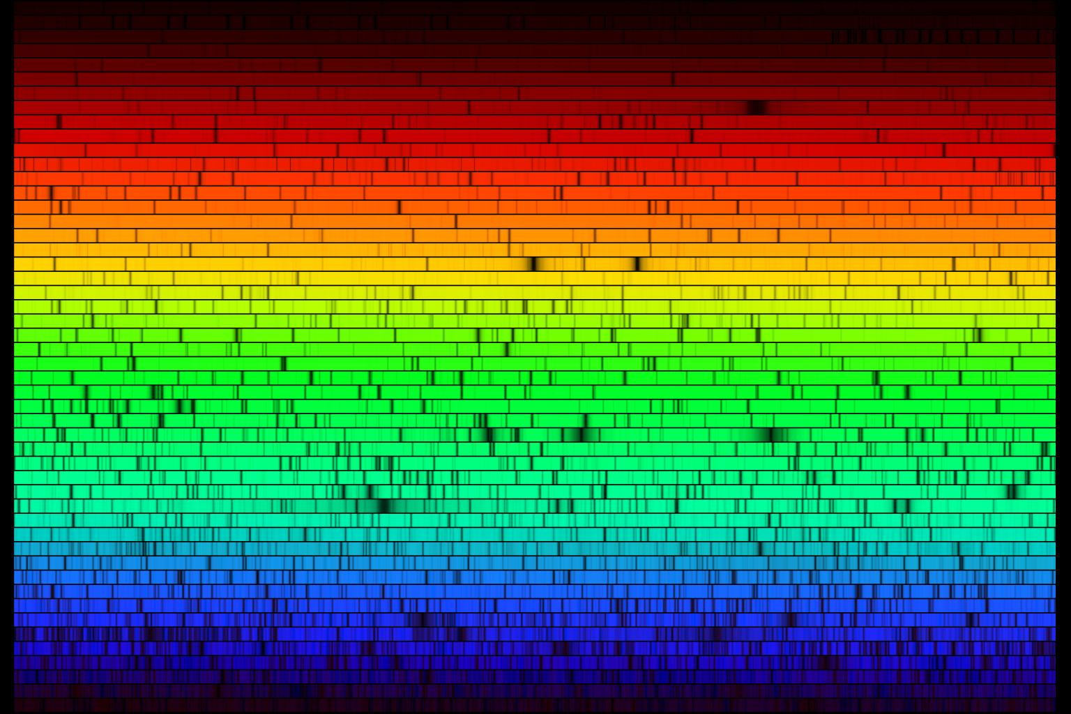
Our famous Octagon room
Student accommodation

Slide 18
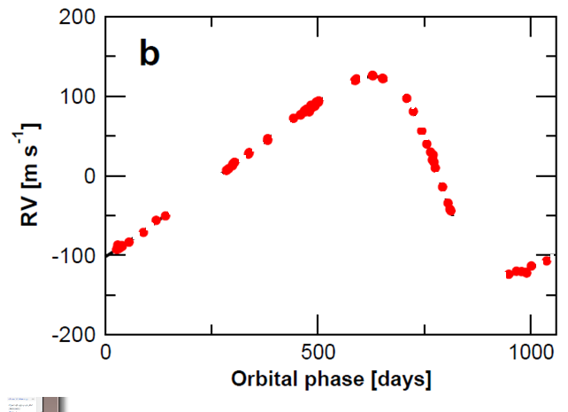
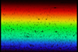
18
Our famous Octagon room
Student accommodation

Slide 19
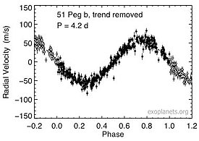
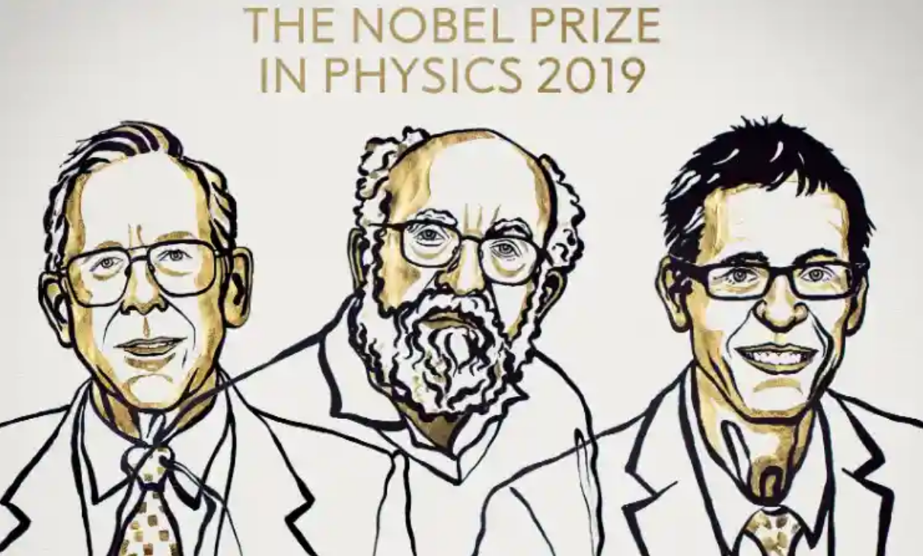
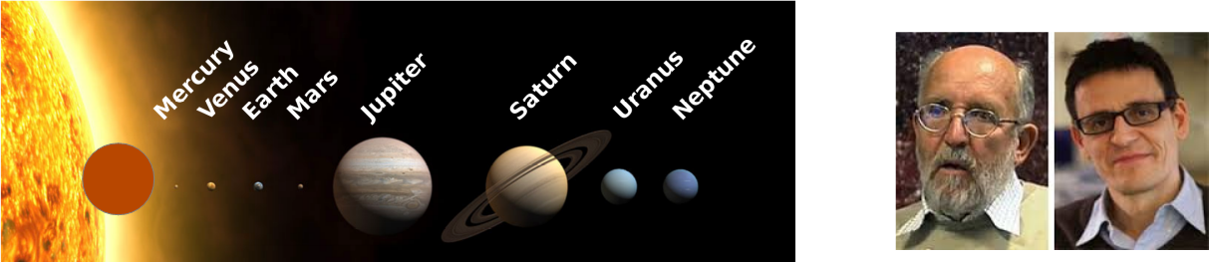
51 Pegasi b – the first exoplanet to be discovered
November 1995
Michel Mayor
Didier Queloz
19
Our famous Octagon room
Student accommodation

Slide 20
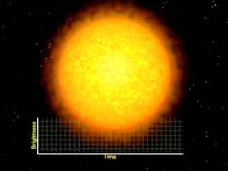
The transit method
For ‘edge-on’ planet systems the transit method detects the apparent dimming of the star as the planet passes between star and observer during each orbit
From radial velocity measurement can determine planet mass
From transit can determine planet radius If we know mass & radius → average density → chemical composition
Our famous Octagon room
Student accommodation

Slide 21
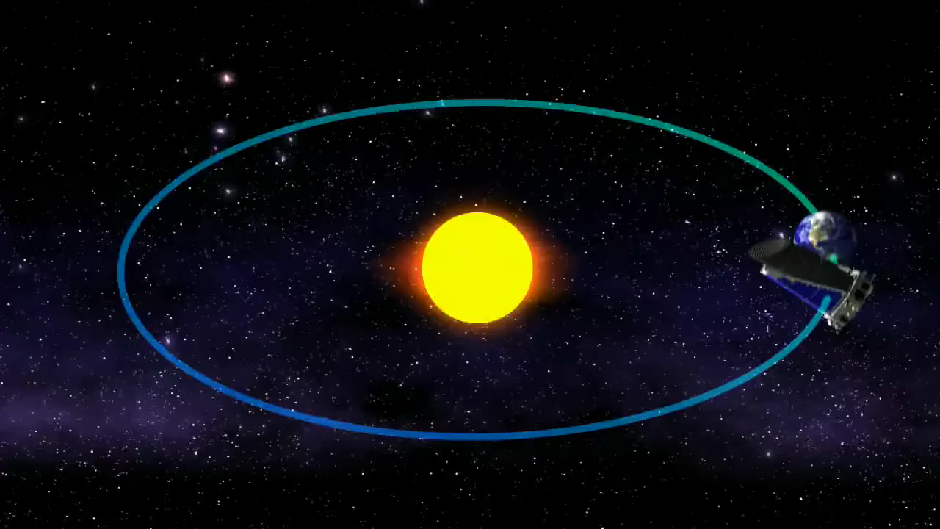
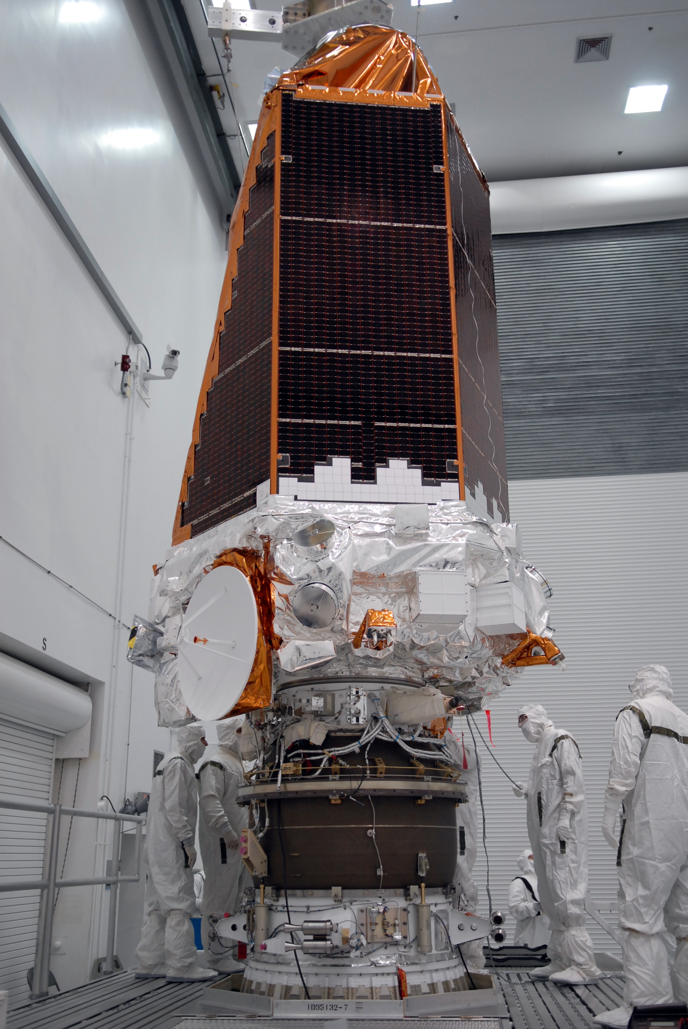
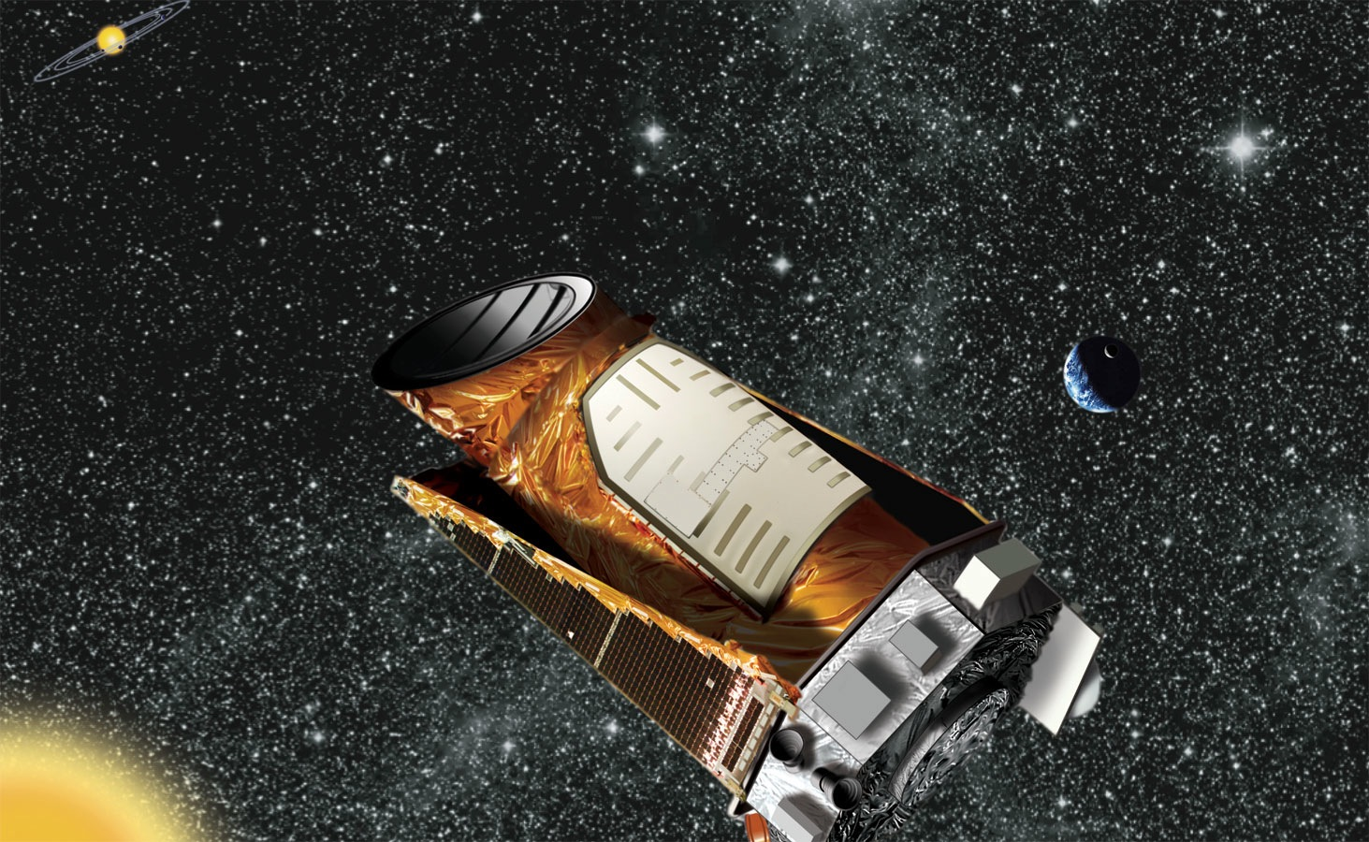

The Kepler mission
Launched 7th March 2009 - in Earth-trailing orbit Transit monitoring of 150,000 stars 4696 planet candidates including 2280 confirmed planets
– but spacecraft pointing broke-down in May 2014
Our famous Octagon room
Student accommodation

Slide 22
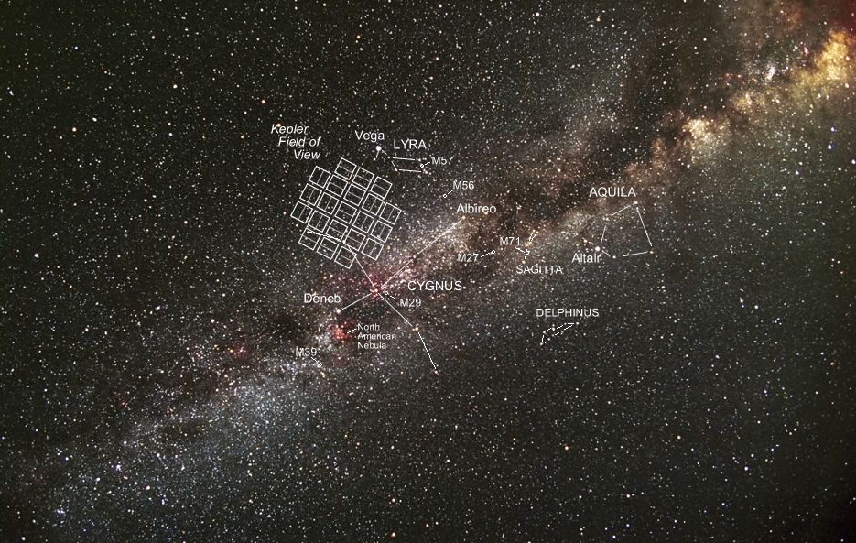
Kepler stared continuously at the same region of the sky in the constellation Cygnus for approximately 4 years
Our famous Octagon room
Student accommodation

Slide 23
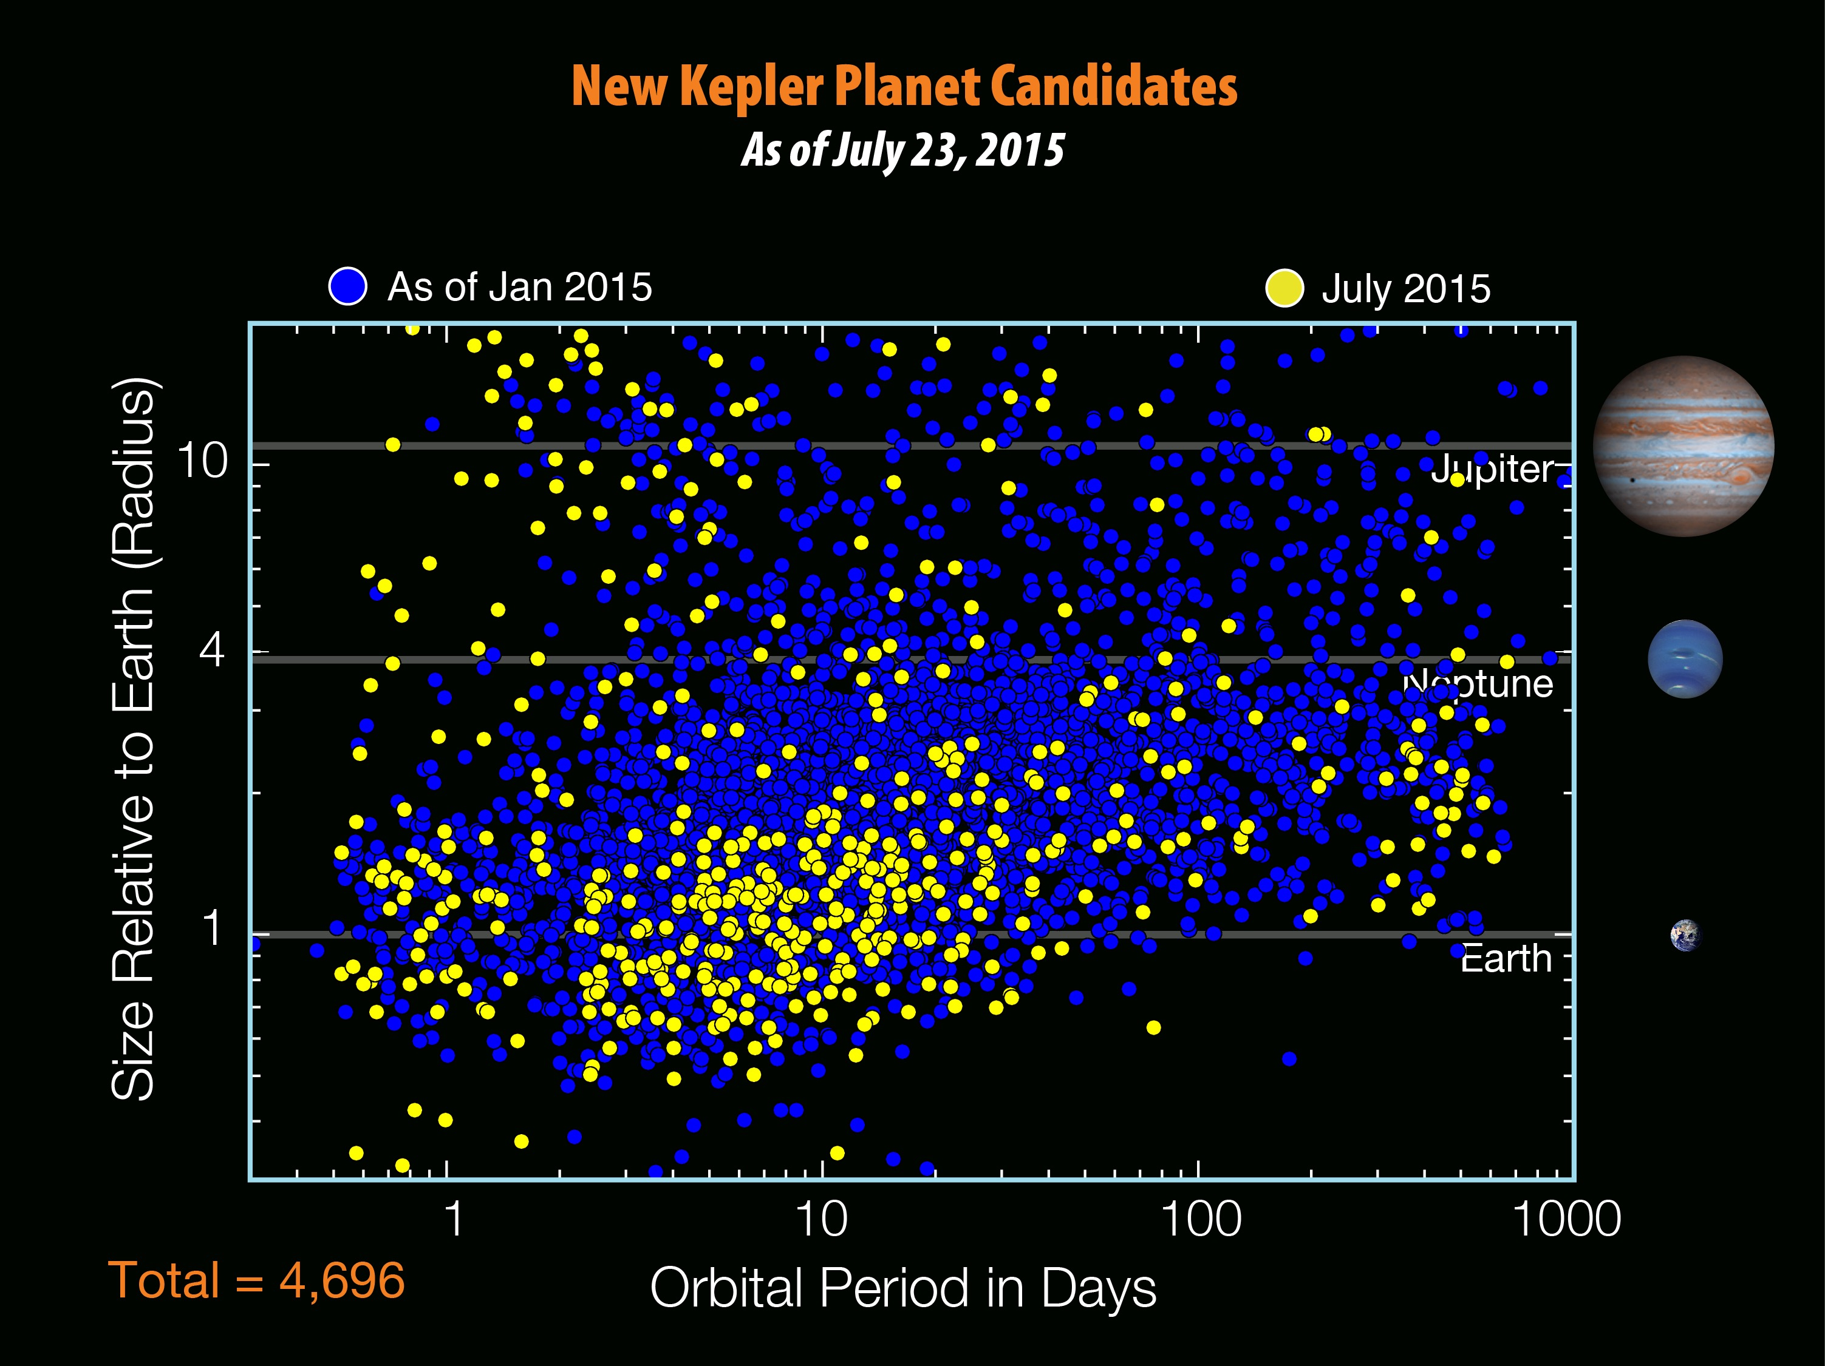
Super-Earths
Our famous Octagon room
Student accommodation

Slide 24
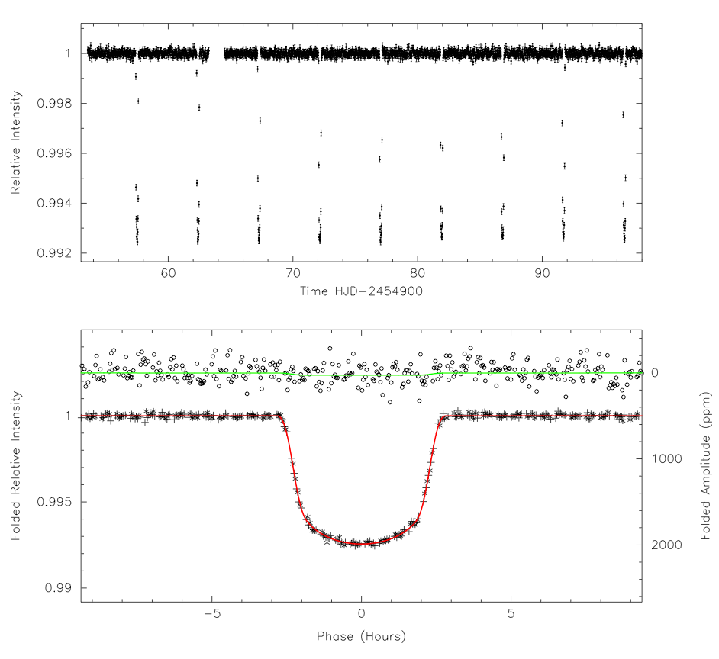
Kepler light curves
Detrended light curve
Phase-folded light curve
Our famous Octagon room
Student accommodation

Slide 25
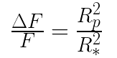
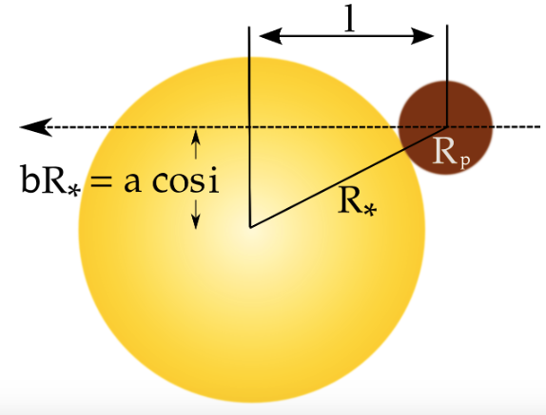
Kepler light curves - what can we tell from the light curve?
Depth of transit planet radius Time between successive transits orbital period
Orbital period + stellar mass + Newton’s laws semi-major axis
Transit duration impact parameter b
Impact parameter orbital inclination to line of sight
Our famous Octagon room
Student accommodation

Slide 26
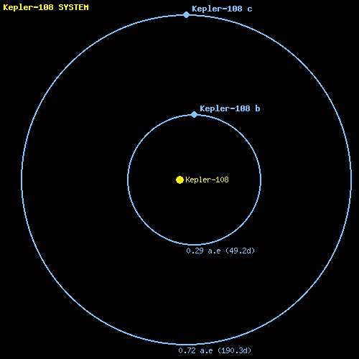
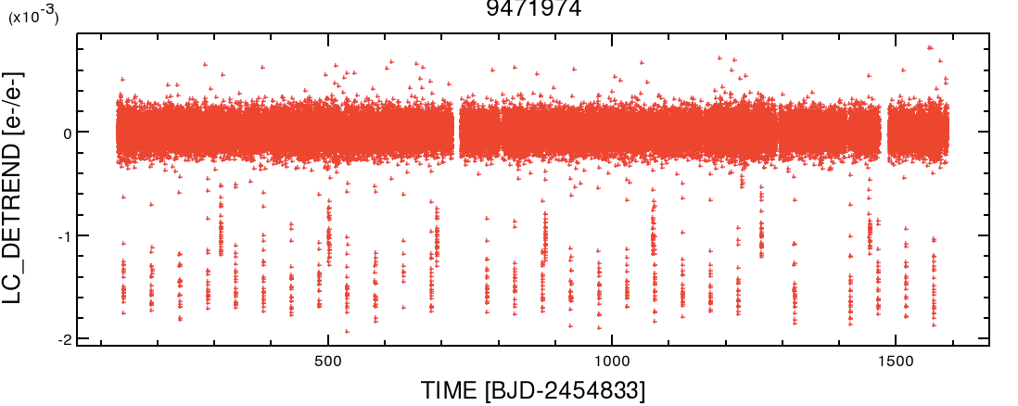
Multi-planet systems
Kepler has found many multiplanet systems - here’s one easy example How many planets are there?
Our famous Octagon room
Student accommodation

Slide 27
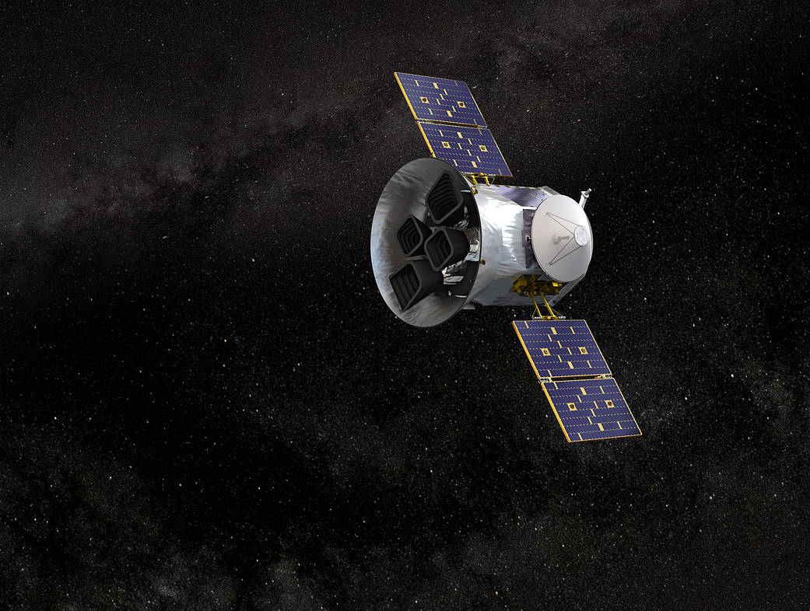
The TESS mission
Launched 18th April 2018 - onto geocentric orbit in 2:1 resonance with the lunar orbit Transit monitoring of 200,000 stars over two years - each stare lasts for ~27 days Now on an extended mission 2394 planet candidates including 81 confirmed planets
Aims to provide accurate radii and masses for 50 planets
Our famous Octagon room
Student accommodation

Slide 28
Programming with Python
How many of you have written programmes in Python?
What are we providing? A GitHub repository that contains:
An introduction to the study of planetary transits + some simple non-programming exercises
An introduction to Python3 programming using Jupyter notebooks
Python programming exercises
An introduction to analysing Kepler data using Python
Transit data from the Kepler and TESS missions for you to analyse
Instructions on how to download more Kepler data
Suggestions for your own research
Assistance when you need it: two pre-arranged sessions per school and ad hoc sessions when required
28
Our famous Octagon room
Student accommodation

